Slide 1
What is a Public Problem? Citizens and Scientific Experts at Play
Pierluigi Barrotta, Roberto Gronda
University of Pisa
pierluigi.barrotta@unipi.it; roberto.gronda@unipi.it

Slide 2
Goal of the Presentation
What makes a problem public?
Provide a taxonomy of the various forms of Citizens (Lay People)/Scientific Experts Interaction that make publicity possible

Slide 3
What is a Public Problem
Some preliminary remarks
Technoscientific and societal aspects are strictly interwoven
Technoscientific aspects should be broaden to encompass the whole body of expert knowledge

Slide 4
What is a Public Problem
A further remark
The object «Public Problem» is not reducible to its techno-scientific components
(transdisciplinarity)

Slide 5
What is a Public Problem
Let’s draw a distinction here:
Social vs Public Problems

Slide 6
What is a Social Problem
A problem is social if it indirectly affects a certain number of people without being adequately perceived as such by them
Antimicrobial Resistance

Slide 7
What is a Public Problem
Problématisation (définition d’une situation problématique) et publicisation (constitution des publics concernés par cette situation) sont les deux faces d’une même dynamique (Cefai & Terzi).

Slide 8
Scientific Experts and Citizens at Play
Enlarged community of inquirers
What kind of cognitive (broadly conceived) contribution may citizens make to public inquiry carried out together with scientific experts?

Slide 9
Scientific Experts and Citizens at Play
1. Citizens as Bearers of Preferences
Citizens are reliable informants about their own desires, values, interests, preferences.
These are elements of the case (public problem-solving cuts across fact/value distinction)

Slide 10
Scientific Experts and Citizens at Play
2. Citizens as Evidence Providers
A possible suggestion:
What about expanding the idea of Local Knowledge?

Slide 11
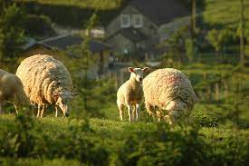
Local Knowledge
B. Wynne,
«May the Sheep Safely Graze? A Reflexive View of the Expert–Lay Knowledge Divide»

Slide 12
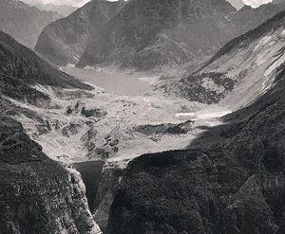
Local Knowledge
P. Barrotta, E. Montuschi, «The dam project: Who are the experts? A Philosophical lesson from the Vajont disaster»

Slide 13
Local Knowledge
S. Epstein, Impure Science

Slide 14
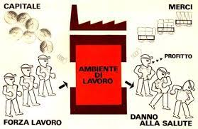
Local Knowledge
M. Capocci, G. Frezza, R. Gronda
«Occupational medicine in Italy: radical movements and the emergence of a new approach (1960- 1980)»

Slide 15
Scientific Experts and Citizens at Play
2. Citizens as Evidence Providers
Shortcomings of the suggestion:
Local knowledge is a form of expert knowledge
Evidence provided by citizens is expendable

Slide 16
Scientific Experts and Citizens at Play
2. Citizens as Evidence Providers
Another possible suggestion:
Citizen Science
a) contributory; b) collaborative; c) co-created

Slide 17
Scientific Experts and Citizens at Play
3. Citizens as Sponsors of Counterexpertise
The notion of undone science (D. Hess) comes in handy

Slide 18
Scientific Experts and Citizens at Play
Definition of Undone Science (Hess 2016, 2):
the systematic absence of research identified by counterpublics when they seek to document potential risks and uncertainties of technologies and industrial processes, and they find that the desired research has not been done or has been significantly underfunded. This absence of scientific research is often in contrast with the much higher quantity of research funded by industry in support of the safety and efficacy of technologies and products.

Slide 19
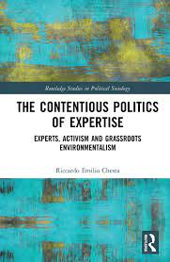
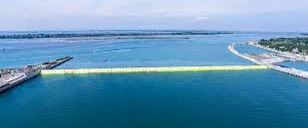
Citizens as Sponsors of Counterexpertise

Slide 20
Scientific Experts and Citizens at Play
Creation of counterexpertise (Chesta 2021, 60):
the expert-activists show a relatively lower scientific status compared to the expert-allies. However, the first ones show a surplus in terms of mobilization resources and experiences that allowed them 1) to raise the issue in public and 2) to open the space for the intervention of the expert-ally, which otherwise would not have had the force to intervene alone in the public sphere.

Slide 21
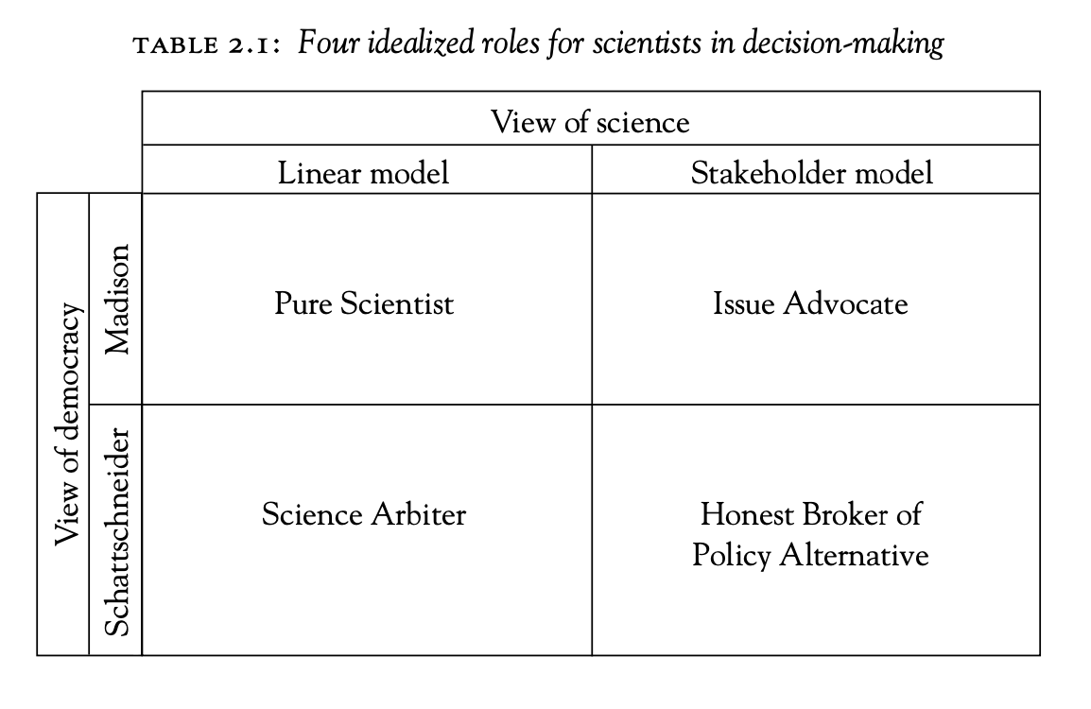
Scientific Experts and Citizens at Play
The idea of citizens as sponsors matches with Pielke’s idea of scientific experts as issue advocates
Expert-Activist
Expert-Ally

Slide 22
Scientific Experts and Citizens at Play
4. Citizens as Semantic Contributors
Is Semantic Deference the only available option?

Slide 23
Scientific Experts and Citizens at Play
4. Citizens as Semantic Contributors
What about «expert» notions such as:
Disease, Well-Being, Sustainability, Risk

Slide 24
Scientific Experts and Citizens at Play
4. Citizens as Semantic Contributors
What about «expert» notions such as:
Disease, Well-Being, Sustainability, Risk
… Influenza

Slide 25
Scientific Experts and Citizens at Play
Bearers of Preferences | Evidence Providers
Semantic Contributors | Sponsors of Counterexpertise

Slide 26
Thank You!

